Slide 1
PST416 STEEPLE CHASE
2021-2022
FIRST SEMESTER EXAMINATION

Slide 2
QUESTION 1
Therapeutic exercise involves the systematic and planned performance of bodily movement, postures or physical activities intended to provide a patient with means to optimize overall health status fitness or sense of well-being
TRUE
FALSE

Slide 3
QUESTION 2
People with chronic lung disease suffer muscle tension from breathlessness, stress and some of the positions needed to ease breathing patterns
TRUE
FALSE

Slide 4
QUESTION 3
In cardiorespiratory conditions, patients frequently forget to contract the accessory muscles and this may lead to muscle tension
TRUE
FALSE

Slide 5
QUESTION 4
Active muscles such as the diaphragm requires relaxation so as to return to its resting position after contraction
TRUE
FALSE

Slide 6
QUESTION 5
Correct positioning but not sensitive handling and provision of information to reduce anxiety can facilitate relaxation
TRUE
FALSE

Slide 7
QUESTION 6
Mitchell Method of Relaxation is also known as the Contrast Method of Relaxation
TRUE
FALSE

Slide 8
QUESTION 7
The application of Sherrington’s law of reciprocal innervation is seen in the ______________ method of relaxation
TRUE
FALSE

Slide 9
QUESTION 8
State the Sherrington’s law of reciprocal innervation
TRUE
FALSE

Slide 10
QUESTION 9
The physiology of the ____________ relaxation method is that a strong contraction of a muscle is followed by an equal relaxation of the same muscle or excitation is equal to inhibition.
TRUE
FALSE

Slide 11
QUESTION 10
Virtual group exercise may be used as a motivational factor for patients to engage in therapeutic exercise
TRUE
FALSE

Slide 12
QUESTION 11
Patients with advanced pulmonary conditions may automatically assume positions such as the tripod position i.e., forward leaning on forearms to optimize accessory muscle use.
TRUE
FALSE

Slide 13
QUESTION 12
The Benson relaxation technique consists of a sequence of contractions of muscles performed in a distal to proximal sequence in each limb or pair of limbs in turn, followed by letting go or relaxation for an equal or longer period of time.
TRUE
FALSE

Slide 14
QUESTION 13
Facilitated stretching is a technique based on the theories and principles of __________________
TRUE
FALSE

Slide 15
QUESTION 14a
Facilitated stretching incorporates active motion and isometric effort to improve flexibility and in process enhance motor learning.
FALSE
TRUE

Slide 16
QUESTION 14b
What is the difference between Hold-relax and Contract-relax?
TRUE
FALSE

Slide 17
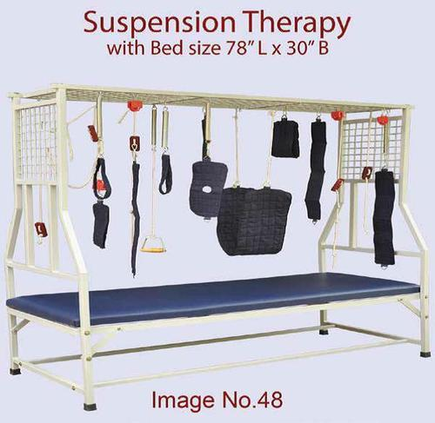
QUESTIONS 15 & 16
15) Name the Figure BELOW
16) What is the figure used for …………?

Slide 18
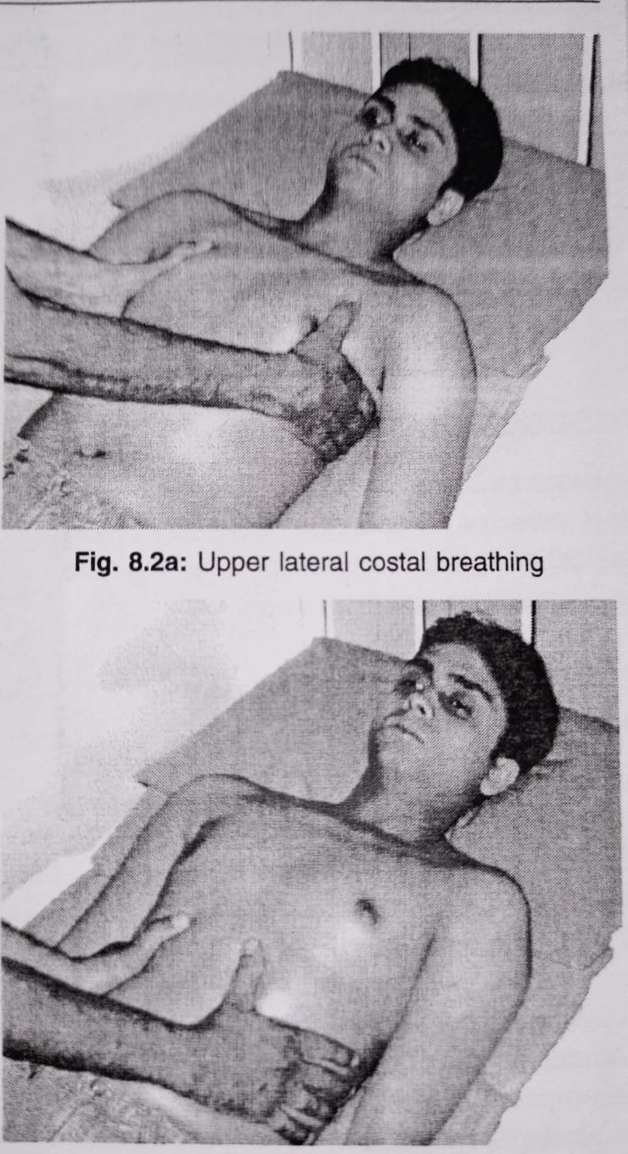
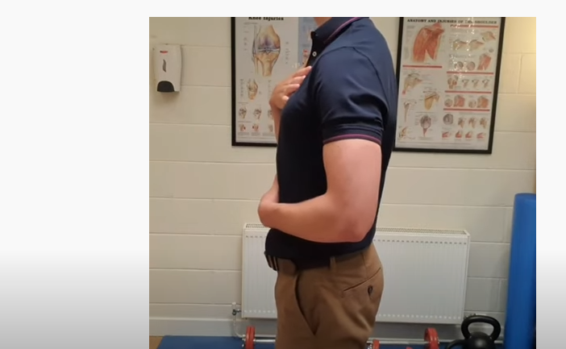
QUESTIONS 17 & 18
Identify the figures below
(17) (18)

Slide 19
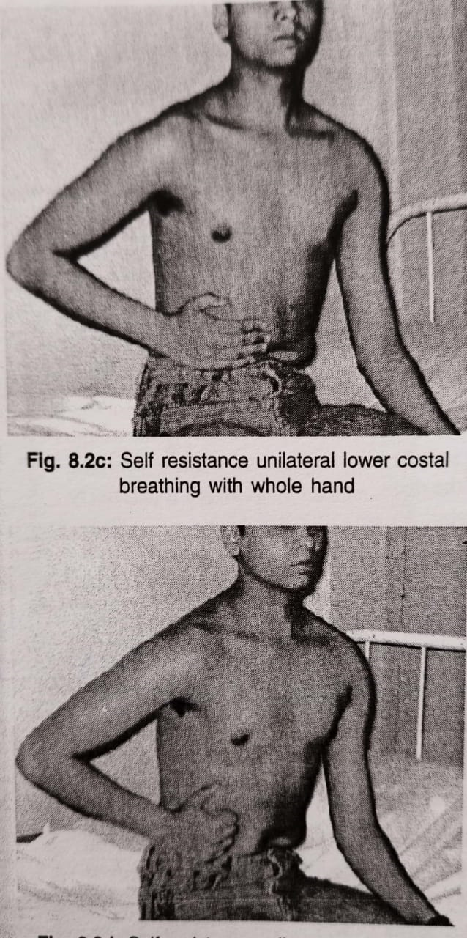
QUESTIONS 19-21
Identify the figures below
(19) (20)
21. State the difference in the breathing technique shown

Slide 20
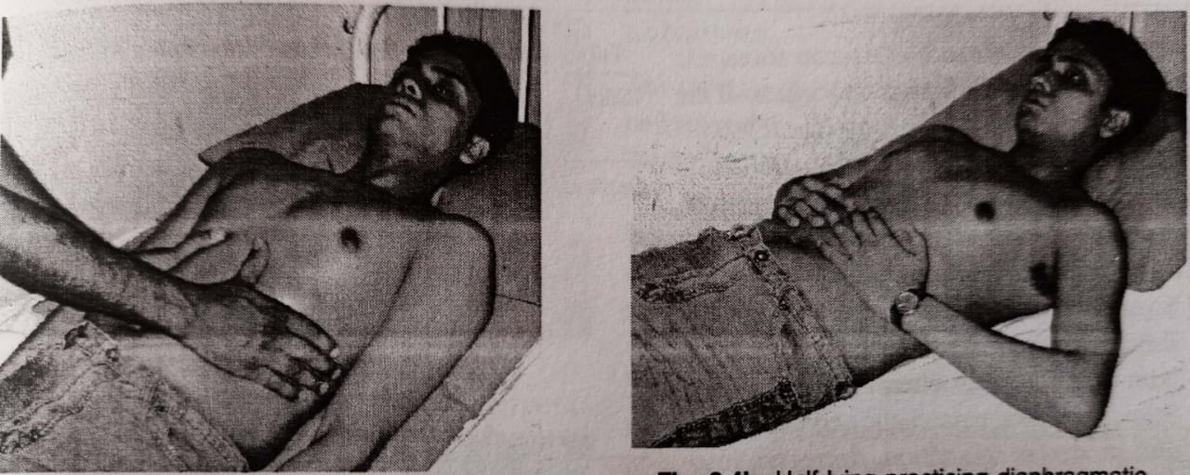
QUESTIONS 22 & 23
Identify the figures below
(22) (23)

Slide 21
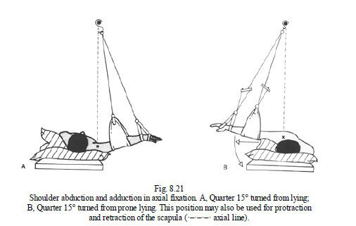
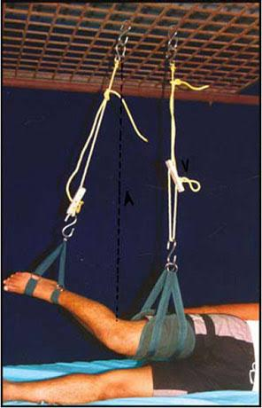
QUESTIONS 24 & 25
Identify the figures below
(24a) (25a)
24b & 25b: Mention one indication for use of each figure

Slide 22
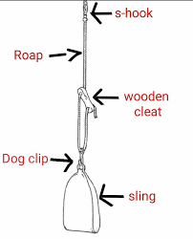
QUESTIONS 26a-e
a
Identify the arrow points (a-e)
in the figure shown
e
b
d
c

Slide 23
QUESTION 27
These components are required for ________________ relaxation.
- A mental device such as a word or phrase.
- A comfortable position that decreases the muscle tone
Adoption of a passive attitude (blocking internal thoughts), which is perhaps the most important of the elements.
A quiet environment

Slide 24
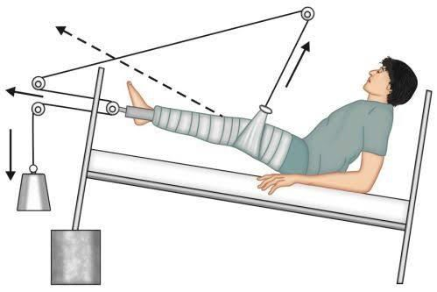
QUESTIONS 28 & 28a-f Name the figure below (28) and label a-f
a
b
c
f
d
e

Slide 25
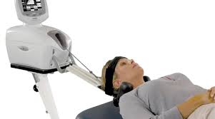
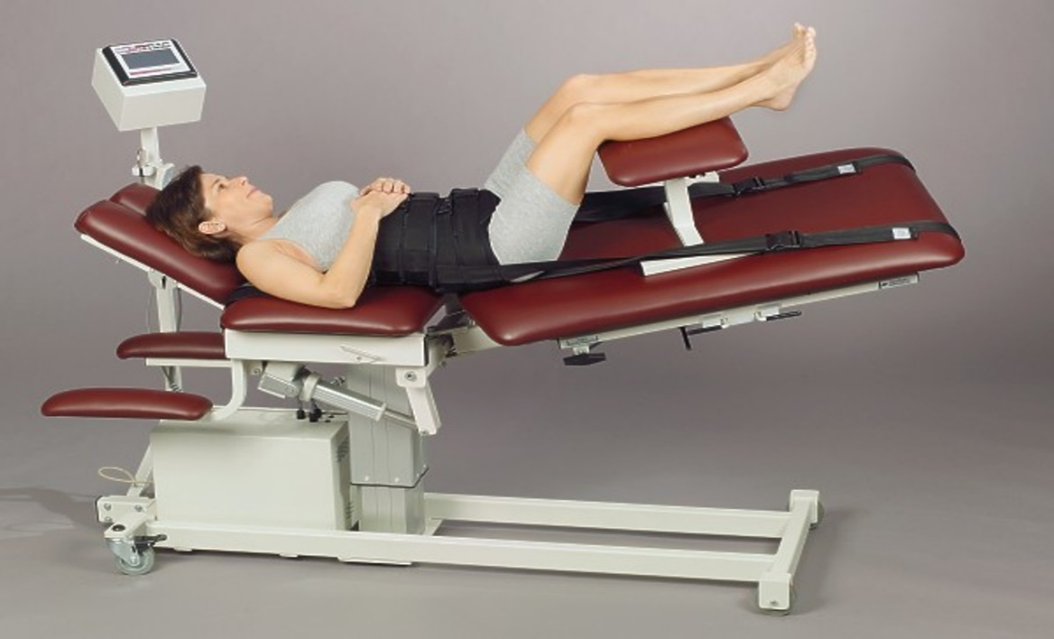
QUESTIONS 29a-b & 30
Identify the figures below
29a
29b
30: List 5 contraindications for figures 29a&b

